Slide 1
uCode
UML and Code Generator
https://github.com/dstoeg/Uml2CodeTool

Slide 2
Overview
Generate a UML Diagram
Generate code from a UML diagram
Choice of language
Quickly generate stub code
Useful for shortening development time
Available as open source project

Slide 3
Supported Features
Inheritance
Aggregation (reference)
Composition
Access Notation
Private
Public
Protected

Slide 4
Patterns and Purposes
Composition
Sharing information between inheritable objects
Factory
Making various types of class objects
Visitor
Getting relevant information from objects
Strategy
Generate code according to language
State
Buttons change GUI
Singleton
Each button and interface should have a single instance
(Bonus) Observer
Update GUI from application logic

Slide 5
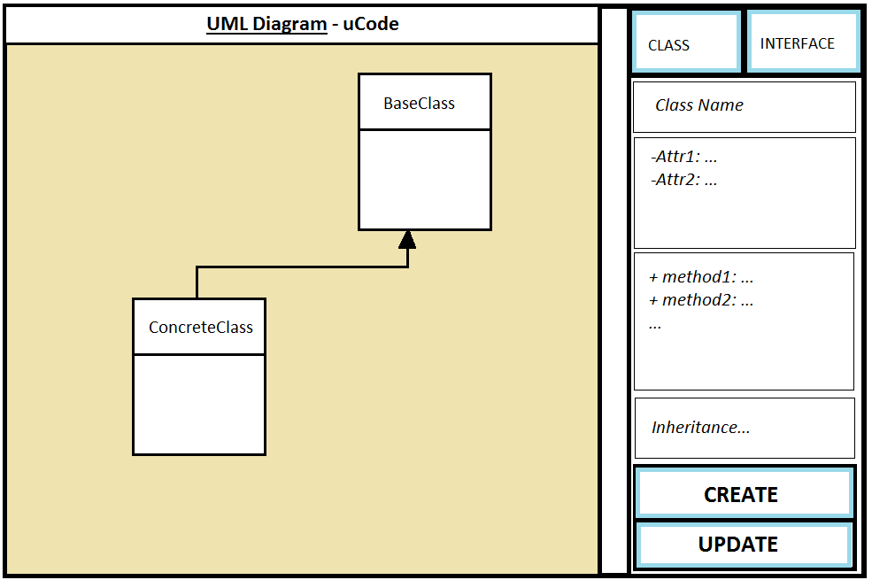

Slide 6
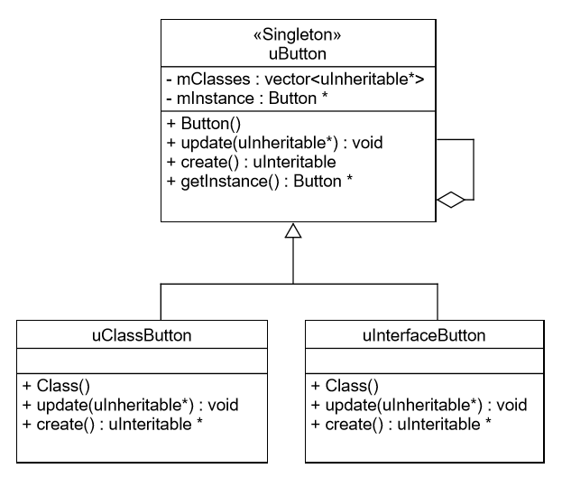
UML – State and Singleton

Slide 7
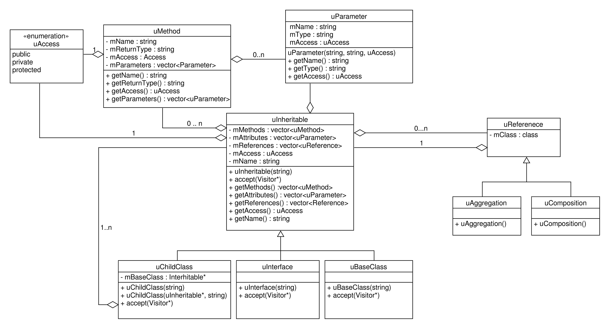
UML - Composite

Slide 8
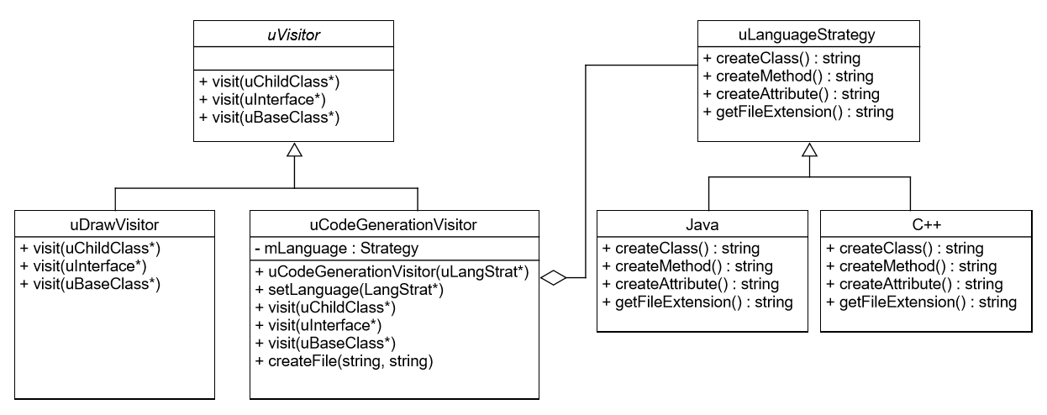
UML – Visitor and Strategy

Slide 9
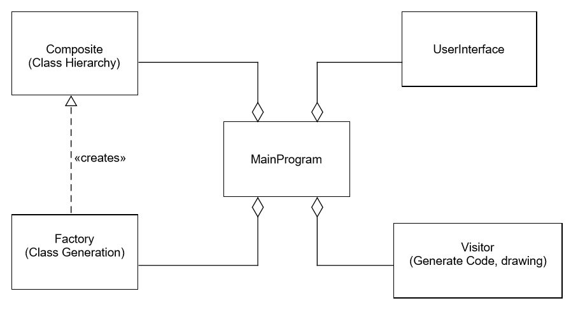
Abstract Overview

Slide 10


Slide 11
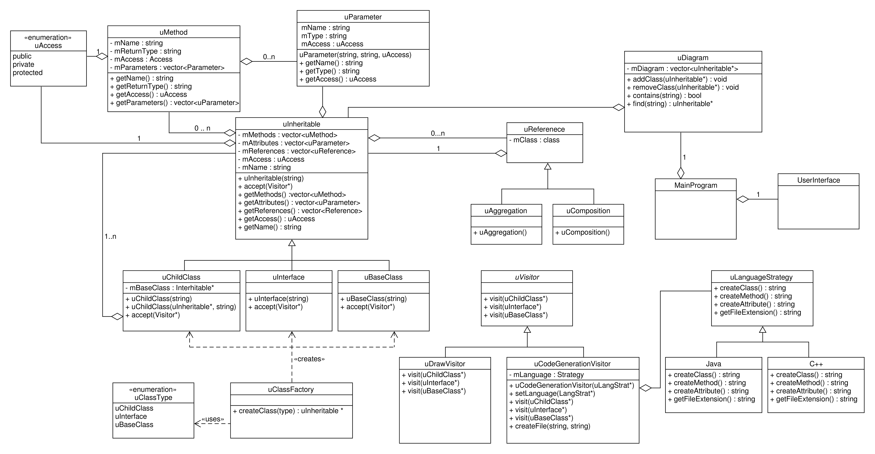
UML - Overview

Slide 12
Functional Requirements
A user should be able to…
Make a new class or interface
Specify a parent class or referenced classes
Add attributes and methods
Click and drag classes
Generate code in a supported language
Export UML Diagram as image

Slide 13
Non-Functional Requirements
Platform independent
Unit testing with QtTest
Maintainable and Extendable
Add support for OO languages (Strategy)
Create various objects at run time (Factory)
Add and Remove features to GUI (State)

Slide 14
Use Cases
Create a class diagram
Create a class template
Add class methods and attributes when given
Specify base class
Add references or contained classes
Generate Code
Specify Language
Traverse class hierarchy
Create files
Generate stub code

Slide 15
Environment
C++ (POSIX)
QT Creator 3.5
QT Library 5.3 (GUI)
QtTest
Git

